Slide 1
IoT Technologies for Embedded Computing: A Survey
Presented by: Sachin Bharadwaj, Vinay Sawant

Slide 2
AGENDA
Introduction
IoT application domains
Devices vs Application
General architecture of an IoT embedded device
Operation stages of IOT applications
Processing and computing layers
Approximate vs Exact computing
IOT sensors
Data rate generation by different sensors
Wireless Communication Technologies
Timing schemes of data transmission
Takeaway

Slide 3
INTRODUCTION
IOT : A multidisciplinary pattern where objects/devices are networked and connected to Internet.
Emergence of Internet-of-Things brings a whole new class of applications and higher efficiency for existing services.
Connectivity (wired or wireless) is what distinguishes embedded IoT systems from conventional embedded systems.
The Internet connectivity, lets devices and smart objects (also known as machines) communicate and interact with (i) other machines and devices, or (ii) humans.
Many research efforts on IoT from the perspective of networking, object identification, security and privacy have been presented.
However, it has gained less attention from the perspective of embedded computing.

Slide 4
IoT Application Domains
Healthcare - personal health monitoring, patient monitoring
Assisted Living - for aged/ disabled/ spl abled people
Smart Building and Home
Smart City
Smart Industry

Slide 5
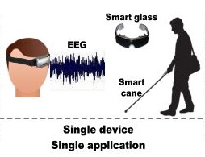
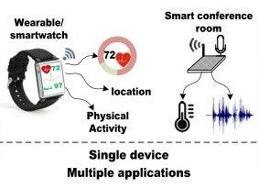
Devices vs Applications

Slide 6
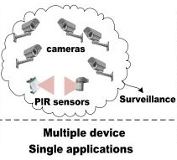
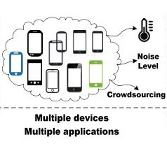
Devices vs Applications (contd)

Slide 7
The IoT embedded designer faces some questions
Q. Which wireless communication technology 1) covers the required range, 2) provides the required data rate, 3) is still (ultra) low-power and meets energy constraints?
Q. What trade-offs to make between 1) Quality of Service(QoS) and energy consumption, 2) on-board processing and computation offloading, etc.?
How to handle the uncertainty and unpredictability of IoT systems (mainly caused by communication)?

Slide 8
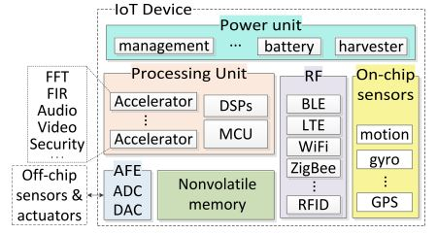
General Architecture of an IoT Embedded Device
Components and units :
Power unit
Processing unit
RF communication modules
On-chip/Off-chip sensors
AFE
Storage unit

Slide 9
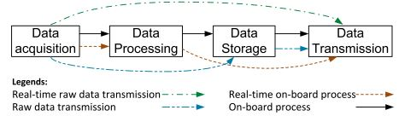
Operation Stages of IOT applications
1) Data Acquisition
2) Data Processing
3) Data Storage
4) Data Transmission

Slide 10
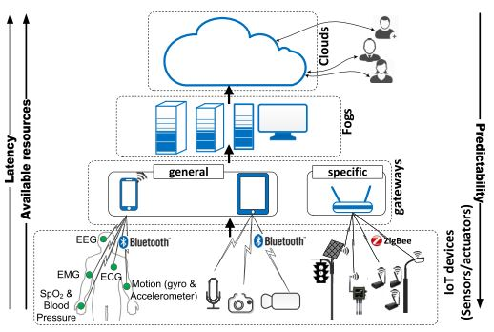
Processing and computing layers
Device Centric
Gateway Centric
Fog Centric
Cloud Centric
Hybrid Approach

Slide 11
Approximate vs Exact computing :
Approximate computing is a computation which gives inaccurate but acceptable results.
It relaxes the requirement of exact equivalence between the specification and implementation to gain more energy efficiency.
Use cases: an approximate multi-bit adder, error-resilient algorithms like image, sound and video processing, data mining.

Slide 12
Approximate vs Exact computing : (cntd.)
Q. Why not exact computing everywhere??
exact solutions comes at a high energy cost.
unnecessary accuracy is wasteful.
But, the final output or QoS should be in a certain range even though the tolerable error can be accepted at hardware and software parts.

Slide 13
The IoT specific characteristics
Interaction with physical world (by means of sensors and actuators).
Communication ability (intra and inter devices communication).

Slide 14
IOT Sensors
Ambient/Object Temperature, Humidity,
Accelerometers and Gyroscopes,
Magnetometer,
Light,
Chemical Sensors,
Location-GPS,
Imaging,
Acoustic,
Ultra Violet (UV),
Ultrasonic,
RF radio modules,
Health Monitoring Sensors- Heart Rate, ECG, EMG, EEG, Blood Pressure, Respiration Rate, SpO2, Skin Conductivity.

Slide 15
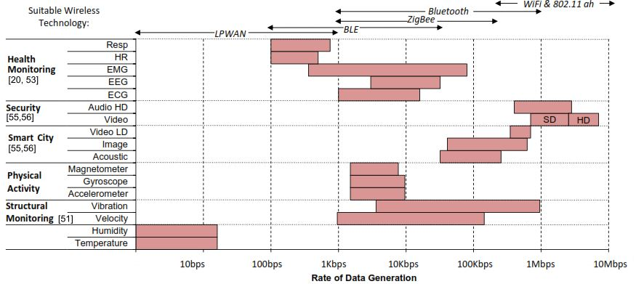
Data rate generation by different sensors

Slide 16
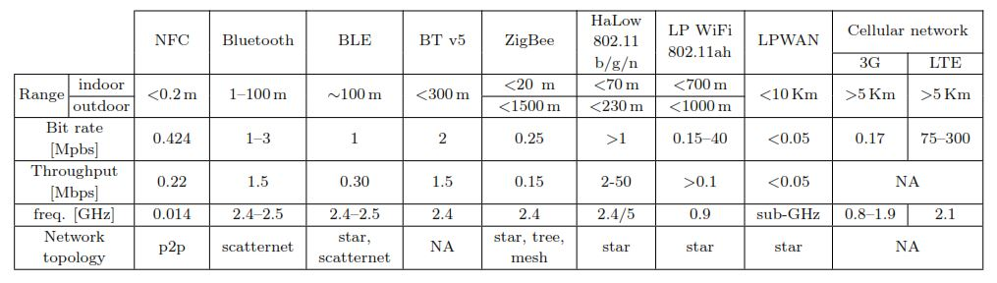
Wireless Communication Technologies

Slide 17
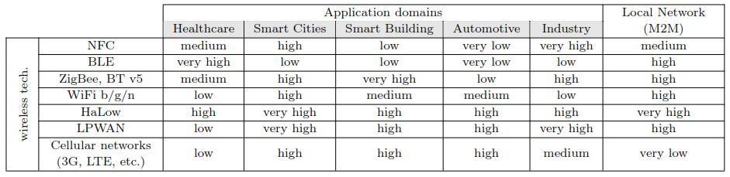
Wireless Communication Technologies (cntd.)

Slide 18
Timing schemes of data transmission
For designing an efficient IoT system, the timing scheme of data transmission matters, especially for managing low power modes (deep sleep, standby, active).
Timing Scheme:
Continuous
Sporadic
On-demand:
User driven
Event driven

Slide 19
Takeaways
N. Kaur and S. K. Sood. An energy-efficient architecture for the Internet of Things (IoT). IEEE Systems Journal.
L. Atzori and A. Iera and G. Morabito. The Internet of Things: A survey. Computer networks, 54(15):2787{2805,2010.
S. Li and L. Da Xu and X. Wang. Compressed sensing signal and data acquisition in wireless sensor networks and Internet of Things. IEEE Transactions on Industrial Informatics, 9(4):2177{2186, 2013.
M. T. Ghoneim and M. M. Hussain. Review on physically flexible nonvolatile memory for internet of everything electronics. Electronics, 4(3):424{479, 2015.
https://www.winsystems.com/cloud-fog-and-edge-computing-whats-the-difference/
http://www.diva-portal.org/smash/get/diva2:1118965/FULLTEXT02
EURASIP Journal on Wireless Communications and Networking
Smartcitizen. Online: https://smartcitizen.me/

Slide 20
Thank You!

